Slide 1
INFO3111: C++ 3D Graphics
Lasciate ogne speranza, voi ch'entrate
With You Host: Michael Feeney

Slide 2
Who am I?
Michael Feeney
LDB Campus (130 Dundas Street)
I coordinate GDP1 (Game Development – Advanced Programming)
I used to coordinate (for a decade or so): CPA2 & 3
Teach in GDP1 and CPA (only the graphics course now)
mfeeney@fanshawec.ca
(Note: mfeeney@fanshaweonline.ca forwards to the above e-mail)
This one.

Slide 3
What’s this course about?
See the CIS (or whatever that’s called now) on FOL
Intro to (soft) “real time” 3D graphics using a C/C++ API. Popular ones:
DirectX (aka Direct 3D), OpenGL, OpenGL ES, Vulkan
The “C/C++” part come into play with:
Choosing the API (not Java, Python, whatever…)
And, yes, I am very well aware that there are “wrappers” to other languages… ☺
Everything that “supports” and organizes the 3D output:
There’s an “animation” component to this, too: things “move/change over time”, so how do we pull that off, in (soft) real time, using C/C++?
How do we manage/maintain/extend this little “framework” we have?

Slide 4
What’s this course about?
Graphics API: we’ll be using OpenGL 4.6 (+glad, GLFW, and glm)
We’ll also need some other glue code:
glad: https://glad.dav1d.de/
GLFW: https://www.glfw.org/
glm: https://glm.g-truc.net/0.9.9/
I may show you some Vulkan, too, but we’ll see how it goes…

Slide 5

3D!! OpenGL!!! C++!!! SWEET, dude!
Let’s write Halo 17! Today!! RIGHT NOW!!!
Hold on, buckaroo…
It’s an introduction
You need to walk before running
Some of this stuff is pretty difficult
There’s some math in here
And a lot of it isn’t intuitive at all…
What CPAs find “challenging” tends to be a little unexpected (more in a moment)

Slide 6
What do you need?
Your brain
Visual Studio 2022 (I’m using Community Edition)
Note: all versions have the same C/C++ compiler (i.e. there’s no difference between versions for C/C++)
Your solutions need to run on my machine (I’ve got 2017, 2019, 2022 installed)
The C/C++ compilers are identical to the other versions (like VS Enterprise, Galactic, World Domination, etc.)
GLFW, glad, and glm

Slide 7
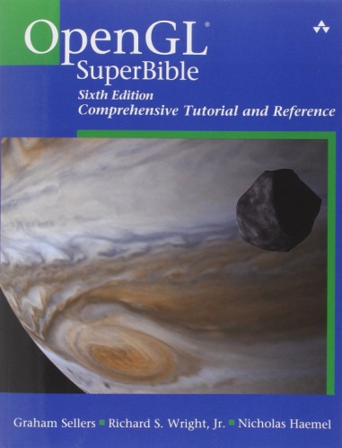

Some suggested books (OpenGL)
OpenGL SuperBible: Comprehensive Tutorial and Reference by Graham Sellers (OpenGL driver team for AMD) et al
OMG! That’s, like, THE TEXTBOOK!!!
#mindblown
Notes:
http://advancedesl.files.wordpress.com/2011/01/15.jpg

Slide 8
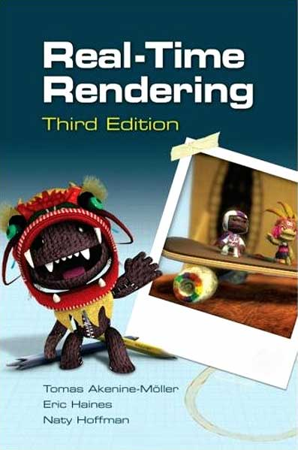
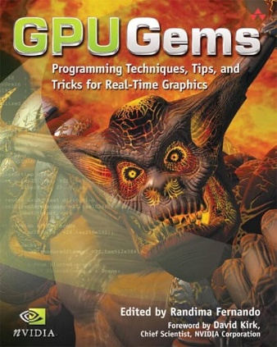
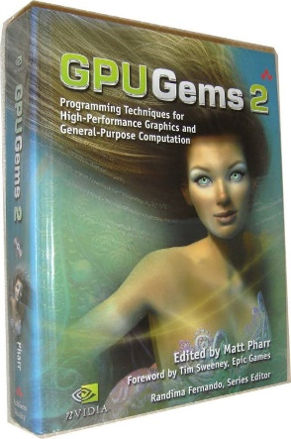
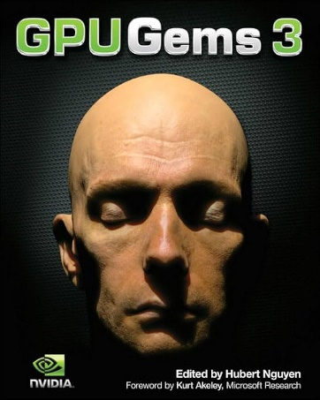
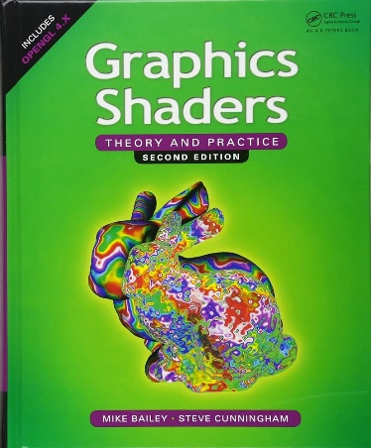
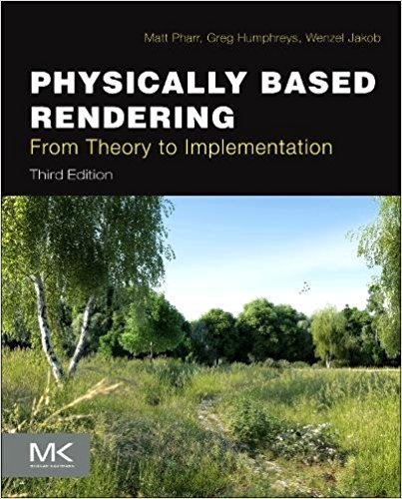
These are good books, too…
They are NOT needed in this course!
And if you are really into graphics
This book won an Academy Award. True Story: https://www.youtube.com/watch?v=7d9juPsv1QU
Notes:
http://advancedesl.files.wordpress.com/2011/01/15.jpg

Slide 9
Two sections:
There are two sections in this class
One is face-to-face, in person
One is online asynchronous
While they have the same lectures, they have different expectations:
In person: I have office hours Tuesday & Thursday from 10 – 11:45
Online: We’ll have zoom and e-mail

Slide 10
What you should know (or will know, soon)
Some C++, and how C++ projects build
compile vs. link, #include issues, file scope, etc.
Some STL (vector, string, map, etc.)
Some basic algorithm stuff, maybe
Including the basics of the STL algorithm
Note: my def. of algorithm might be very, very different from yours… heads up
Some debugging skills
How to pay attention
How to keep “plugging along” (Coolidge)
Don’t know some (all?) of that?
Well, that’s why you’re in school, right?

Slide 11

What you want to know...
You
What you already know
Valley of confusion, lack of knowledge and skill, and frustration...
Notes:
http://hinglecoaching.com/images/mission%20man2.jpg

Slide 12
But I’m, like, SUPER IMPATIENT, man!!!
Why can’t we do something, like, TODAY!?
I mean, we could use, like, a GAME ENGINE!
Or Flash? HTML 5.0? Or Unity?? Why not that? It’s so “easy”!
Come ON!!!
...Let me give you two analogies...

Slide 13
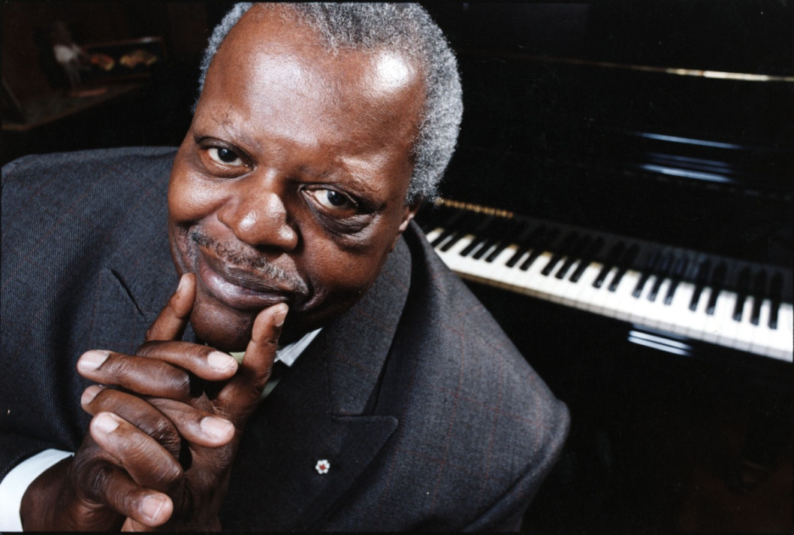
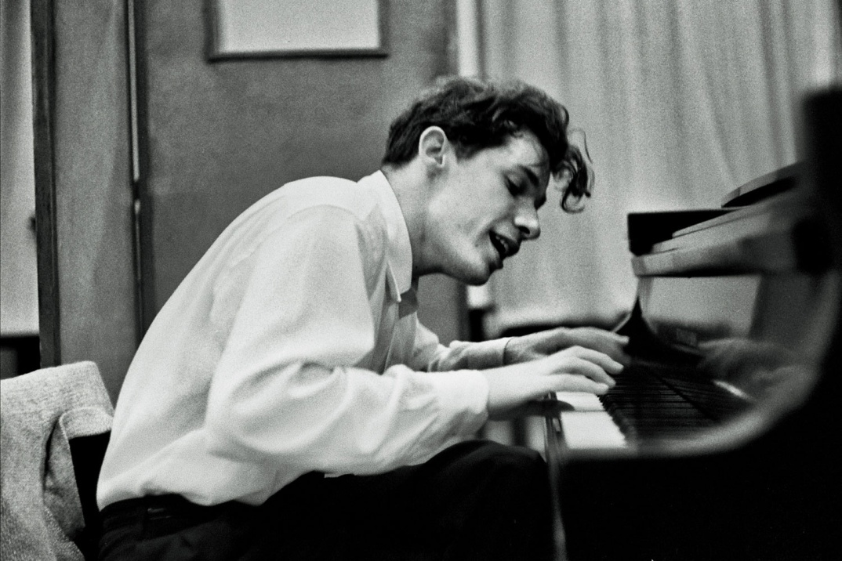
This is Glenn Gould & Oscar Peterson
They were two of the greatest piano players in history
If you wanted to play like these guys, how would you go about it?
Notes:
http://www.thestar.com/content/dam/thestar/entertainment/music/2013/11/07/oscar_peterson_award_to_be_handed_out_at_york_u_gala/oscar_peterson.jpg
http://www.parkinggaragepolitics.com/wp-content/uploads/2013/03/Glenn-Gould-Source-Unknown.jpg

Slide 14

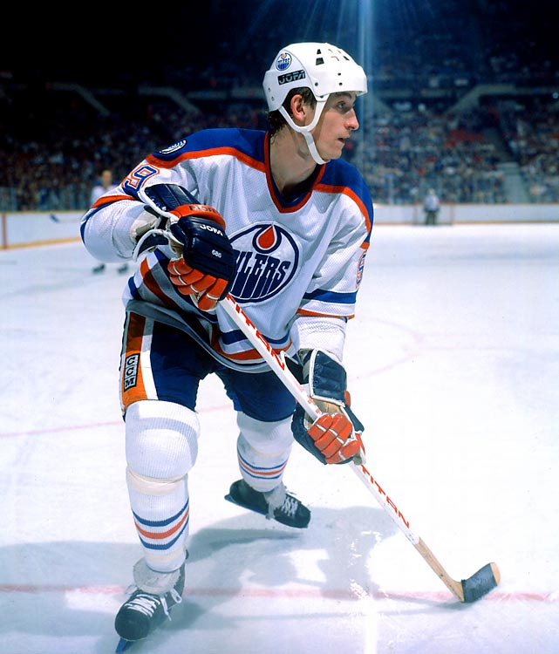
Or how about Bobby Orr or Wayne Gretzky?
Again, if you wanted to play like these guys, how would you go about it?
Notes:
http://i.cdn.turner.com/si/multimedia/photo_gallery/1004/revolutionary.moments.in.sports/images/wayne-gretzky.jpg
http://www.bobbyorrcollector.com/wp-content/uploads/2011/11/img165-784x1024.jpg

Slide 15
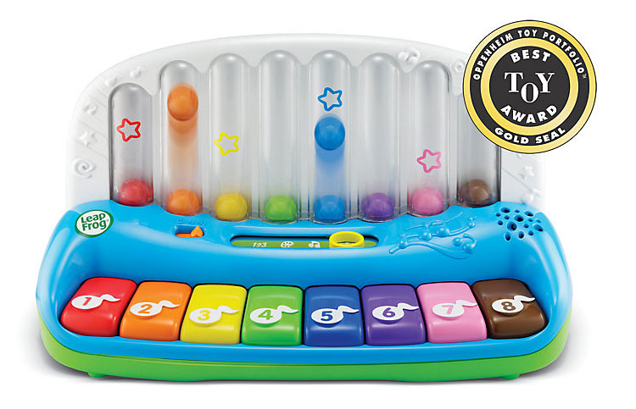

Simple, but no simpler…
Well, we could start with something like this...
But eventually, we’d have to use the real thing.
Notes:
http://images.amazon.com/images/G/01/toys/detail-page/c26-B00804BDE0-1-l.jpg
https://img1.etsystatic.com/000/0/6308893/il_fullxfull.305981903.jpg

Slide 16
Commercial graphics APIs… (DirectX, OpenGL, Vulkan, Metal, etc.)
Are very mature
Aren’t intended to be “for beginners”
There’s a lot of things that can “go wrong”
There’s a lot of things you have to know before you can be even remotely productive
(Just like playing an instrument...
...or being ½ way useful at a sport, right?)
You’re going to screw up/fall down... a lot.
They are very low level (are “C”, NOT “C++” APIs)

Slide 17

Michael’s hand
(normally not yellow)

Slide 18
Where Michael worked and does work
Fanshawe, obviously.
Precision Robotics (now Brooks automation)
Original job out of school was electronic design, embedded, etc.
Contract work for (selected):
Intel, Exxon Mobil, nVidia, AMD, various robotics companies, too many game companies to list
Dev for published games on PC, shield, switch, Xbox 360 & One, PS4 & 5, HoloLens, Oculus, SteamVR, SteamDeck (older iOS & Android 🤮)
Lots of driver and tool development
99% of this is C, C++, and shader stuff

Slide 19
What’s this course not about (1/3)?
Ray-tracing.
Old OpenGL (fixed function pipeline)
Pre OpenGL 2.0 (glVertex(), etc.)
DirectX: (there are a lot of similarities with OpenGL)
GDI, GDI+, Flash, HTML 5, WebGL, or any other graphics APIs
Vulkan. It’s not for beginners and is only useful if you are “CPU bound” (we aren’t)

Slide 20
What’s this course not about (2/3)?
“Game stuff” beyond basic graphics and rudimentary “animation” in OpenGL
If you want more game stuff, take GDP1 after CPA
Why? You’ve got enough to cover already

Slide 21
What’s this course not about (3/3)?
“Stupid” unnecessary programming/C++ stuff:
Pointless (aka. unnecessary) templates
Pointless (unnecessary) classes/inheritance
Any combination of the words “best” and “algorithm”
Anything the committee added “because it’s cool” or “modern”
Look into how the C++ committee is run…
It’s not a real reflection of what the programmers are doing/wanting
The “best” way to do something.
This like arguing what’s “the best piece of LEGO” and missing the point that you’re supposed to me MAKING something with the LEGO…

Slide 22
Whatever is really in use, currently
I’ll be showing some code you may haven’t seen.
That’s because it’s what’s done.
Think about it: all the C/C++ code that’s out there now → what version is it? C++ 15? 17? 20?
But how?
https://en.cppreference.com/w/cpp/compiler_support
Remember that C++ 11 didn’t come out in 2011…
It also took 10+ years for the committee to stop fighting ratify
Don’t confuse “new” with “better”
A lot of the newer standards fix mistakes from older standards. Seriously.

Slide 23
Some other things
Sometimes I’ll show you things (like C++ arrays) because there’s flaws in some implementations of the STL and/or standard
“Well it works on my machine…” isn’t a good reason
You’re supposed to be learning stuff, right?
I’m 100% OK with discussing/explaining, but don’t test my patience or waste class time
- i.e. I’m not wanting this to descend into a stack overflow style argument or some “news and views” nonsense.

Slide 24
Other things
No boost and other 3rd party libraries.
If you use boost in your exams or projects, they will not be marked. Find another way.
boost is *written in* C++, but boost != C++
“auto” keyboard. Just no.
I reserve the right to give you zero if you use auto.
Yes, I’m very aware of what it does, etc.
Any other library: ask me first, but likely “no”
Just do it the way I asked because I ask you to.

Slide 25
chatGPT, etc. : Here’s The Deal
I’m expecting you to know how to do this.
This doesn’t mean “just getting an answer”
If I suspect that you don’t know the code you submitted (either you copied it, chatGPT’d it, got it from another site…) then I will ask you about it, one on one, face to face (or zoom)
At that point, you need to prove to me that you actually know what the heck you are talking about.
It’s a “guilty until proven innocent” situation.
If you are clueless, then you cheated.

Slide 26
C & C++ “rant”/clarification:
C/C++ are “strongly typed”, “unmanaged” languages
They were never intended to be weakly typed/managed
The API we’re using is in C. Virtually all “C++” out there is using C APIs underneath.
Originally (“1970s”) C is a nightmare, though
malloc() vs calloc()? Seriously? Give me strength…
X++ vs. ++X Please tell me you’re kidding me… 🤦‍♂️
Templates are always better/faster. Oh good gawd.
It’s not Java/C#/JavaScript, etc.:
the libraries will not help you here. (Those languages absolutely rely on the libraries)

Slide 27
How you pass

Slide 28
Your marks…
“Project” mark: 40%
10-12 checkpoints worth 10% TOTAL
(Lowest 2 marks will be dropped, so you can miss 2)
2 projects worth 15% each
Projects are due right before the exam, and are intended to help you prepare for the exam
“Exam” mark: 60%
Midterm and final (each 30%)
You have to pass the exam portion to pass the course
50% is a “pass” in this AND EVERY OTHER course.

Slide 29
Checkpoints: 10%
Assigned at the end of class
Due at the start of the next class
There are no extensions or late marks, since I’ll be giving you the solutions.
You should do them yourself.
There are no late marks (since I will be giving a solution at the next class.)
There might be a “bonus” checkpoint at the end, worth 2%, added directly to your mark (up to the 40% of the “projects” portion)
The students who do their own checkpoints tend to do better on the exams. Really?! Who would have thought?

Slide 30
2 Projects: 15% each
Due right before the exams.
Unless there are “exceptional circumstances” (Policy A-131), if you miss the deadline, you get zero (that is the policy, by the way)
You should do them yourself.
There are no late marks
Unless there are “exceptional circumstances” (Policy A-131)
If you miss the deadline, you get zero (that is the policy, by the way)
Projects are intended to help you with the exam. i.e. if you did well on your project (delivered what I ask for) then you should pass the exam.

Slide 31
2 Exams: 30% each
2 of them: mid-term (around day 7/8) & final (day 14/“exam week”)
“3 hours” in that you can complete it in 3 hours.
Face to face, in person students: you’ll write exams in class, in a 3-hour time block at the usual class time.
Asynchronous students: will have a different exam that you have a time window to complete and submit.
There’s no “late submission” window for exams.

Slide 32
“Part marks”
Students seem to love “part marks.”
Now, I’ll try really hard to be fair, but:
Have you ever had a plumber “almost” fix your toilet?
Did you pay them?
Ever “sort of” broke your leg?
Get a cast for that?
Ever “almost” paid your mortgage?
How did the bank like that?
Did you buddy “almost” pay you that $50 they owe?
Did you call that square?
Would you loan them money again?
If your code won’t build, then I can’t mark it. Period.
You can’t “almost” meet a checkpoint.

Slide 33
Mike Acton ; 3 lies
https://cellperformance.beyond3d.com/articles/2008/03/three-big-lies.html
Software is a platform
PS3 game -> Atari 2600
Code should be designed around a model of the world
Code is more important than data

Slide 34
Data
Code
Data

Slide 35

Good news, everyone!
We’re going to code now!

Slide 36
And now…
…enough goofing around…
Ladies and Gentlemen, start your Browser and Visual Studio.
We’re going to get some OpenGL code, get it running, and go from there.
While we are doing that, I’ll start explaining “what is OpenGL”

Slide 37
cout.h
GLFW.h
Blah
Our C++
printf() / cout
Out OpenGL
Blah
Blah
cout.lib
GLFW.lib

Slide 38
Git

Slide 39
Feeney’s copy (origin)
Your local copy

Slide 40
OpenGL libraries, etc.

